Slide 1
Announcing the release of the CT Lightspeed 1X-4X ePST!
What is an ePST?
The CT Lightspeed 1X-4X ePST
Please send us your feedback!

Slide 2
What is an ePST?
ePSTs are Electronic Performance Support Tools
ePSTs enable you to quickly troubleshoot and repair imaging systems.
Each ePST covers a specific system.
They are developed by FE’s for FE’s in a functional format with intelligent hyperlinks enabling the troubleshooting of problems involving multiple components across multiple subsystems.
They have a consistent format so that once you know how to use one, you know how to use them all.
They enable you to fix the most common problems even if you have never worked on that type of system before.

Slide 3
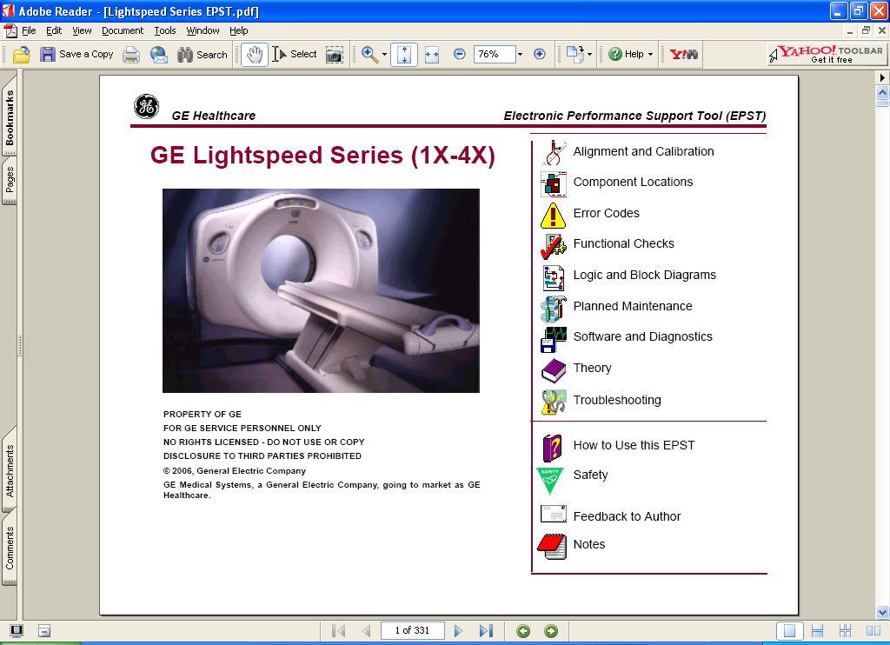
The CT Lightspeed 1X-4X ePST
Using this ePST could save you time and money! You can launch it right from your Lightspeed Family Service Info DVD, part no. 2360027-300.

Slide 4
Please send us your feedback!
Once you have used it, please go to this link and send in your feedback on the CT Lightspeed 1X-4X ePST:
http://bronze-web-prod.health.ge.com/itsurvey/docs/secure/survey_form.jsp?ID=16805&Key=WI1P6MM70C6ZC4X
We would like to know if you have suggestions as to how the ePST could be improved. We would also like you to share how the ePST helped you. Did you have a big win in labor or material because of the ePST? Please tell us. There is even a place to indicate whether you would like someone to give you a call! ☺

